Slide 1


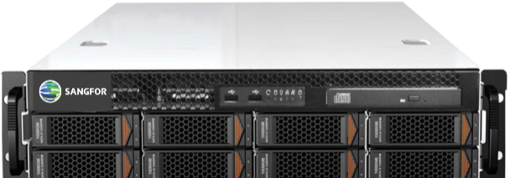
Sangfor HCI 6.9.1
SCMT Migration Tool
www.sangfor.com
Sangfor Technologies Inc.

Slide 2
1
Tool/Platform Introduction
2
Migration Practices
3
Migration principle

Slide 3
PART 1
Tool/Platform Introduction

Slide 4
SCMT Introduction
SANGFOR Cloud Migration Tools/Platforms (SCMT or SCMP) can provide production migration (P2V/V2V) capabilities and support the smooth migration of services from physical servers, mainstream virtualization platforms, and public cloud/private cloud platforms to Sangfor HCI(Sangfor Cloud)platform. It can meet the business migration requirements of the following scenarios:
    P2V (Physical to Virtual): Migrating the entire X86 physical server operating system to Sangfor cloud platform, including HCI or Managed cloud platforms.
    V2V (Virtual to Virtual): the virtual machine of VMware/KVM/Xen/Hyper-V and other platforms will be migrated to the Sangfor Cloud platform.
    V2C (Virtual to Cloud): the same as V2V, the target is the Sangfor Cloud platform.
    C2C (Cloud to Cloud): the same as V2V, the source end is the others cloud platform (such as Alibaba Cloud, Huawei Cloud, Tencent Cloud), and the destination end is the Sangfor Cloud platform.

Slide 5
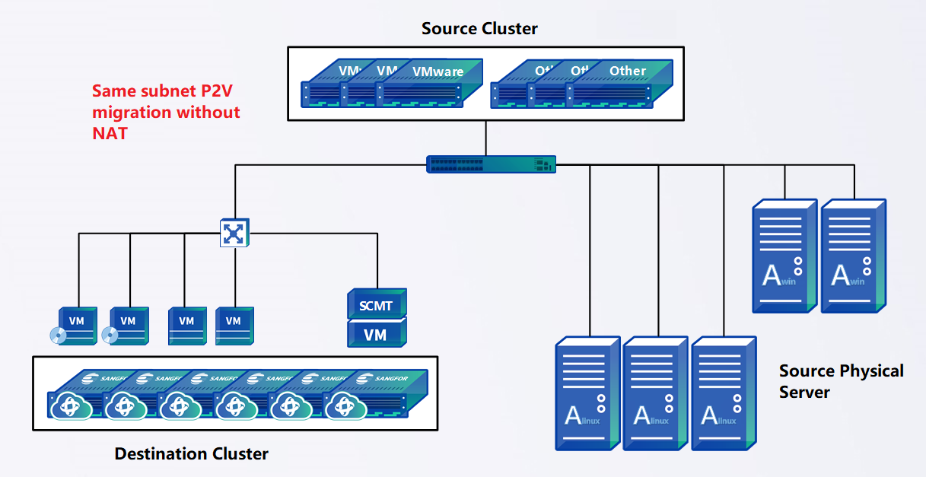
SCMT Migration Model
Bare Metal Restore
Windows Agent
Linux Agent
SCMT(VM)

Slide 6
Components
Server
VMA File - Import into HCI
ISO File - For physical server deployment
For HCI version before 6.0.0 need to use ISO for deployment
Materials and package
Sangfor Community
Source
Physical server/VM- Agent
VMware(5.5-7.0) - Agentless
Destination
Bare metal restore ISO – To construct destination VM
SANGFOR HCI6.0.0R5, 6.3.0, 6.3.0R1, 6.3.0R2 – Automatically create destination VM

Slide 7
Main features
The migration process does not need to interrupt the source server production, while only needs to temporarily suspend the production when switching service.
Migration supports manual service switching to ensure the production downtime is under control.
After SCMT connected to the HCI platform, VM configuration will be available when creating migration task which simplified the configuration operation before and after migration.
For virtual machines migrated to the HCI platform will automatically install vmtools。
Migration supports effective data replication, encryption, compression, bandwidth speed limit, and resumable syncing
Support hot backup (CDP+HA) for migration to reduce service switching time
Hot backup is based on the operating system layer, and can use the backup data to create a new destination machine without manually creating an operating system
Notes:
Point-to-point migration wizard configuration interface, the destination supports selecting the specified HCI platform.
Before migration, automatically plan the destination VM configuration according to the source server specifications. The API will be called to automatically create the destination machine.
Automatically mount the bare metal restore media on the destination machine before migration.
Automatic driver compatibility after migration.
Bare metal restore media support DHCP or manually configure IP address.
Compatibility processing, automatic installation of Sangfor performance optimization tools (Sangfor Vmtools).
Retain the migration method of manually creating the destination machine.

Slide 8
Compatibility List
Operating System: Mainstream Windows and Linux with 32/64 bits OS
Filesystem: ext2, ext3, ext4, xfs, FAT, FAT32, exFAT, NTFS, Refs
Device Format: LVM, GPT, MBR, Dynamic Volume, Spanned Volume, Striped Volume
Precaution: Raw disk is not supported
VMware ESXi : 5.5 / 6.0 / 6.5 / 6.7 / 7.0
VMware vSphere : 5.5 / 6.0 / 6.5 / 6.7 / 7.0
SANGFOR HCI :
  For 6.0.0R5, 6.3.0, 6.3.0R1, 6.3.0R2, support destination VM auto creation(support API integration).
  For other version, manual creation of destination VM is required.

Slide 9
PART 2
Practices

Slide 10
Port and network requirement
22,80,443
Server
Manage PC
80,20000-200047
80,20000-200047
26000-26600
3345
26000-26600
22/3389,20000-20047
Source
Destination
Scenario | Source IP | Dest IP | Dest Port | Protocol | Port service
Migration Task Manage | Manage PC | Server | 22 | TCP | SCMT sshd service
 | 管理PC | SCMT | 80,443 | TCP | SCMT Web service
source server agent installation | Source | Server | 80 | TCP | Download agent
 |  |  | 20000~ 200047 | TCP | Data replication port
Dest connect server
 |  |  | 26000~ 26600 | TCP | Transmission of control information during point-to-point switching
Source replicate data to dest | Source | Server | 22/3389 | TCP | Manage destination OS
 |  |  | 20000~ 20047 | TCP | Data replication proxy port
During migration, required network latency within 50ms and packet loss within 5% between source to the destination HCI cluster.

Slide 11
Migration Method
Migration | Desc | Scenario | Precautions
Point-to-point Migration | Sync the source server data to destination VM | OS switching with 5-10 minutes production interruption. Suitable scenario: Recommended for most of the scenario, support standalone database server migration | Clustering production not supported for migration RDS database, container platform(docker, k8s), big data platform not supported
Hot backup migration | Data has been backup through full backup + CDP backup Production switching with HA technology | OS switching with 1 minute production interruption Suitable scenario: core production with higher requirement on production availability. | SCMT need to have backup datastore with 1.5 times capacity.
Backup migration | Data has been backup through full backup + incremental backup Production switching with HA technology | OS switching with 15-30 minutes production interruption. Suitable scenario: large data size, small bandwidth or physical relocation | SCMT need to have backup datastore with 1.5 times capacity.

Slide 12
Impact to production during migration
Environment preparation phase
No impact to source machine.
Data replication phase
During replication, agent CPU occupation to source less than 3%
The peak memory consumption is less than 260MB. Recommend to have 1GB available/usable memory before migration
By default, the replication has been limited to occupies 30% of the source storage performance, and the read queue depth is 4. The limit can be adjusted manually.
By default, the bandwidth usage of the source network is limited to 300Mbps. The limit can be adjusted manually
Production switching phase
Point-to-point migration: Production switching with 5-10 minutes production interruption.
Hot backup migration: Production switching with around 1 minutes production interruption. Backup migration: Production switching with around 15 minutes production interruption.

Slide 13
Authorization
Authorize based on number of machine to be migrate
License according to number of machine, for example there are 5 VMs to be migrate, then will need 5 VMs license. The license will decrease after each migration task completed.
Apply license based on user_id
SCMT license will be generate based on the user id accordingly.
Provide the user id for the SCMT license generation.
Testing License
By default, will provide with 10 VM license, where the validity is 30 days.
Note: For 2022, SCMT will be free of charge in IMD. Apply the license according to the project requirements.

Slide 14
PART 3
Migration principle

Slide 15



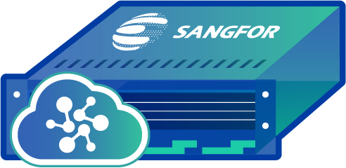


Overview of the migration process
Agent
4
Automatically adaptation to HCI
API
3
Production data transmission
VMware
VM
VM
VM
VM
VM
APP
APP
APP
DATA
DATA
DATA
APP
APP
APP
APP
APP
VM
VM
OS
OS
OS
DATA
DATA
DATA
DATA
DATA
Agent
OS
OS
OS
OS
OS
production hot migration
LAN
SANGFOR Cloud
Cloud platform
HCI Cluster
Agent
SCMT
Physical Server
2
Migration Visualization
Agent Installation
5
HCI VM performance adjustment after migration
1

Slide 16





Point-to-point migration with agent
3
Configure migration task, distribute migration task
7
Production service stopped, distribute switching task
Source: X86 Physical Machine/VM
SCMT
2
Auto or manually create destination VM, mount with bare metal restore and configure IP(to communicate with SCMT and source machine)
Destination: HCI VM
1
Source machine install agent
Agent
Bare Metal Restore
4
Full data copy
9
Virtual driver compatibility handling with vmtools auto installation
Manually stop service in source machine(not shutdown)
5
Incremental data copy
6
10
Destination VM reboot(boot from disk), takeover the production
8
Sync the last incremental data, action to source machine depends on the switch action

Slide 17
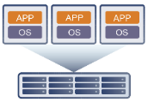

Point-to-point migration with agentless
1
Added vCenter into SCMT virtual data center to get VM resource
Stop production, distribute switching task
9
3
Configure source – destination migration job
Source: Vmware
SCMT
Destination: HCI VM
4
Accept migration task, notify VM for snapshot
2
Auto or Manually create destination VM, mount with bare metal restore iso and configure IP(connect to SCMT and source machine)
API
Bare Metal Restore
5
Call the VADP function, get vmdk image raw data
6
Forward to destination vm through server side proxy
Virtual driver compatibility handling and auto install vmtools
11
7
Full data copy + N times incremental data copy
Destination VM reboot(boot from disk) and takeover production.
8
Manually stop the application/service in source machine(not shutdown)
12
vdisk*.vmdk
Sync last incremental data, perform switching operation.
vdisk*.qcow2
10
Notes:
Note that the VM in vCenter/Vmware can only add by one system admin.
Example, there are 3 VMs in vCenter, VM A,B and C.
While user A added the vCenter into SCMT with VM A, other user will only be able to add VM B and C.

Slide 18

Hot backup migration
5
Create hot backup plan after CDP full backup completed.
1
Source machine install agent
3
Create CDP backup for source machine
SCMT
2
Manually create destination vm mount with bare metal restore iso and configure IP(connect to SCMT)
Agent
9
Distribute hot backup switching task
Bare Metal Restore
6
Source machine CDP data will be sync to destination machine through SCMT
11
Activate destination machine, takeover production
4
First CDP full backup, transmit the data to SCMT through agent
10
Sync the last incremental data and verify it. When switching, will change IP setting of the source machine accordingly.
7
Full backup synced to destination vm, vmtools auto installed with compatibility handling.
Destination machine will be in OS boot status and accept the CDP incremental data.
8
Manually stop the application/service in source machine(not shutdown)

Slide 19





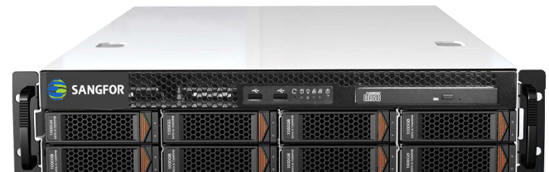

Backup migration(Large data migration)
Sync incremental data
XYCloud Data Center
Internet/VPN/MPLS
Region：Indonesia
Region：Indonesia
Local Data Center
Publish SCMT to internet
SCMT in physical server
SCMT in physical server
Move the server from local data center to xycloud data center
Tenant VPC
Enable shared service to connect SCMT
Backup the data to SCMT
Recover the data and up the VM
Explanation：
Suitable for data size 30TB above, low bandwidth scenario.
Might need apply for additional server for storing full backup in local data center and move to destination server room for incremental backup.

Slide 20
THANK YOU
Technical Support Service
Email: tech.support@sangfor.com
Community: community.sangfor.com

